Slide 1
Al-Farabi Kazakh National University
Higher School of Medicine
Department of Fundamental Medicine
Pharmacogenomics
Lecturer and creator: PhD Pinsky Ilya Vladimirovich
Notes:
Weaver, PART I

Slide 2
LEARNING OUTCOMES
As a result of the lesson you will be able to:
1. Explain the difference between the terms “pharmacogenetics” and “pharmacogenomics”.
2. Characterize the mechanisms of genetically based human reactions to the medical drugs, give the specific examples.
3. Describe the methods of pharmacogenomics.

Slide 3
Definitions
Pharmacogenomics is the study of the role of the genome in drug response. Its name (pharmaco- + genomics) reflects its combining of pharmacology and genomics. Pharmacogenomics analyzes how the genetic makeup of an individual affects his/her response to drugs.[1]
Pharmacogenetics focuses on single drug-gene interactions, while pharmacogenomics encompasses a more genome-wide association approach, incorporating genomics and epigenetics while dealing with the effects of multiple genes on drug response.[2][3][4]

Slide 4
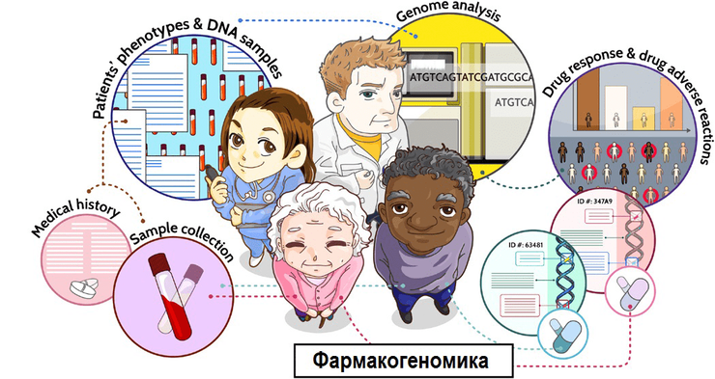
https://biomolecula.ru/articles/farmakogenomika-izuchenie-genov-na-sluzhbe-personalizirovannoi-meditsiny

Slide 5
History
Pharmacogenomics was first recognized by Pythagoras around 510 BC when he made a connection between the dangers of fava bean ingestion with hemolytic anemia and oxidative stress. This identification was later validated and attributed to deficiency of G6PD in the 1950s and called favism.[5][6] Although the first official publication dates back to 1961,[7] circa 1950s marked the unofficial beginnings of this science. Reports of prolonged paralysis and fatal reactions linked to genetic variants in patients who lacked butyryl-cholinesterase (‘pseudocholinesterase’) following administration of succinylcholine injection during anesthesia were first reported in 1956.[8] The term pharmacogenetics was first coined in 1959 by Friedrich Vogel of Heidelberg, Germany (although some papers suggest it was 1957 or 1958).[9] In the late 1960s, twin studies supported the inference of genetic involvement in drug metabolism, with identical twins sharing remarkable similarities to drug response compared to fraternal twins.[10] The term pharmacogenomics first began appearing around the 1990s.[5]
The first FDA approval of a pharmacogenetic test was in 2005[11] (for alleles in CYP2D6 and CYP2C19).

Slide 6
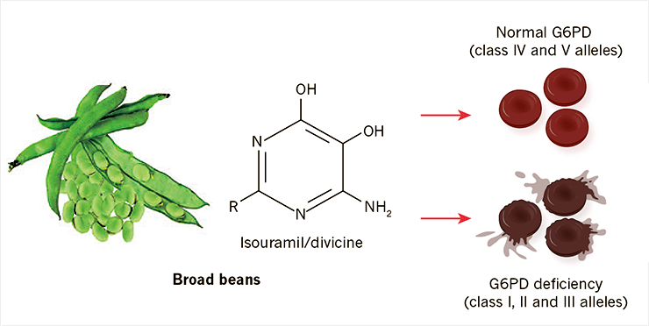
Mary V. Relling, William E. Evans. (2015). Pharmacogenomics in the clinic. Nature. 526, 343-350

Slide 7
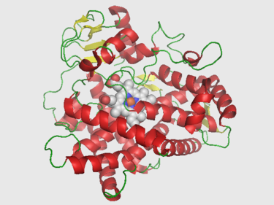
Drug-metabolizing enzymes
Cytochrome P450s
VKORC1 (Vitamin K epOxide Reductase Complex (VKORC) subunit 1
TPMT (Thiopurine methyltransferase)
https://en.wikipedia.org/wiki/CYP2D6

Slide 8
Drug Metabolism of Major CYPs^{[12][13]}
Enzyme | Fraction of drug metabolism (%) | Example Drugs
CYP2C9 | 10 | Tolbutamide, ibuprofen, mefenamic acid, tetrahydrocannabinol, losartan, diclofenac
CYP2C19 | 5 | S-mephenytoin, amitriptyline, diazepam, omeprazole, proguanil, hexobarbital, propranolol, imipramine
CYP2D6 | 20-30 | Debrisoquine, metoprolol, sparteine, propranolol, encainide, codeine, dextromethorphan, clozapine, desipramine, haloperidol, amitriptyline, imipramine
CYP3A4 | 40-45 | Erythromycin, ethinylestradiol, nifedipine, triazolam, cyclosporine, amitriptyline, imipramine
CYP3A5 | <1 | Erythromycin, ethinylestradiol, nifedipine, triazolam, cyclosporine, amitriptyline, aldosterone

Slide 9
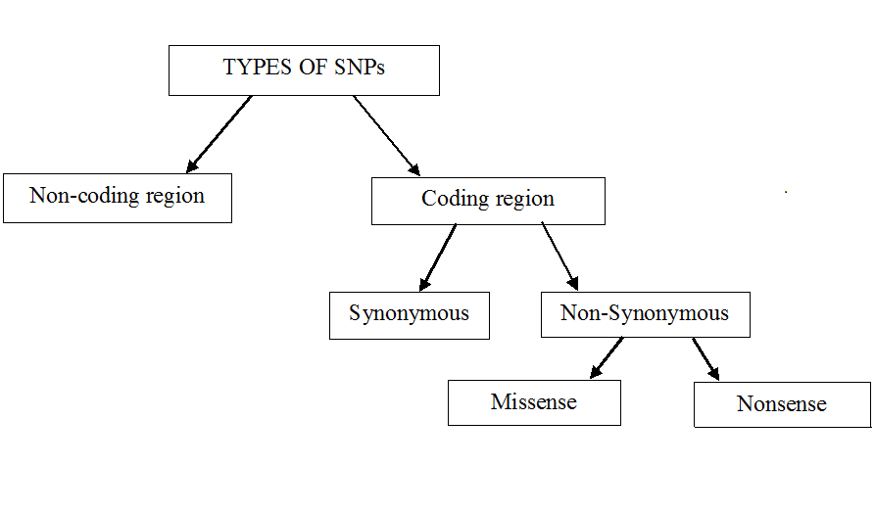
https://en.wikipedia.org/wiki/Single-nucleotide_polymorphism#/media/File:Types_of_SNP_new1.png

Slide 10
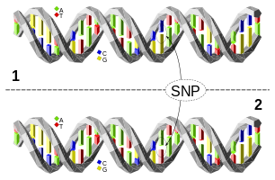
The upper DNA molecule differs from the lower DNA molecule at a single base-pair location (a C/A polymorphism).
https://en.wikipedia.org/wiki/Single-nucleotide_polymorphism

Slide 11
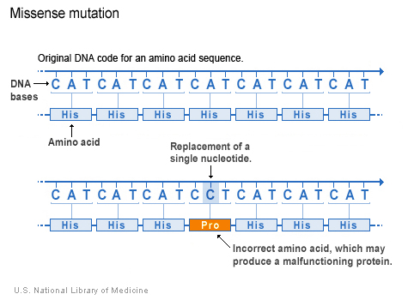
http://ghr.nlm.nih.gov/handbook/illustrations/missense

Slide 12
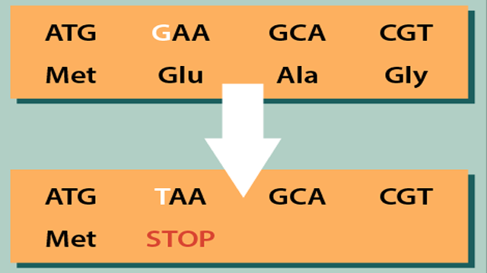
Non-sense mutation
https://www.technologynetworks.com/genomics/articles/missense-nonsense-and-frameshift-mutations-a-genetic-guide-329274

Slide 13
Methods of pharmacogenomics
Genome-wide association study (GWAS)
Genome sequencing methods
Genotyping:
Restriction fragment length polymorthism (RFLP)
Polymerase chain reaction (PCR)
Amplified fragment length polymorphism (AFLP)
DNA microarray and etc.

Slide 14
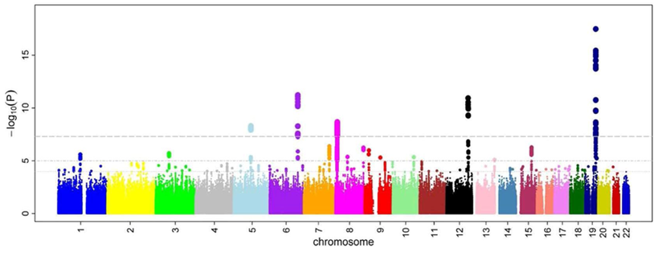
Genome-wide association study (GWAS)
In genetics, a genome-wide association study (GWA study, or GWAS), also known as whole genome association study (WGA study, or WGAS), is an observational study of a genome-wide set of genetic variants in different individuals to see if any variant is associated with a trait. [14]

Slide 15
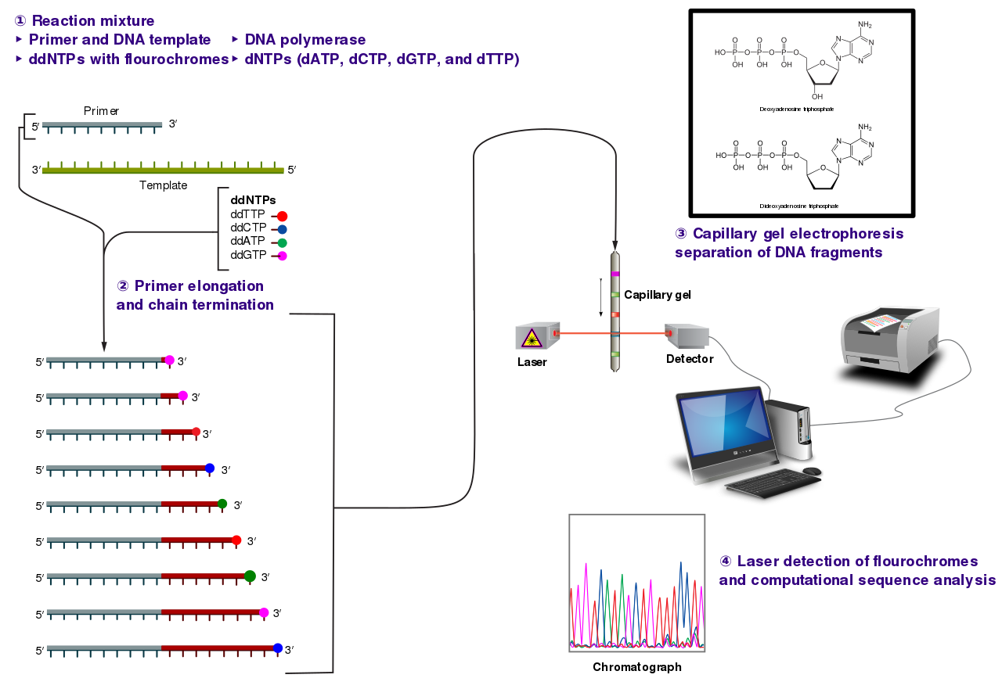
The Sanger (chain-termination) method for DNA sequencing.
https://en.wikipedia.org/wiki/Sanger_sequencing#/media/File:Sanger-sequencing.svg

Slide 16
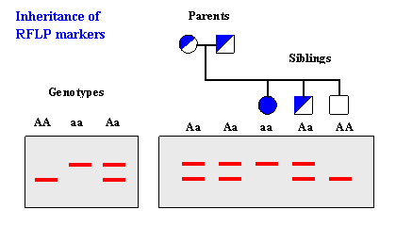
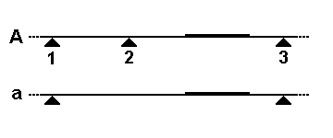
Restriction fragment length polymorphism
https://en.wikipedia.org/wiki/Restriction_fragment_length_polymorphism

Slide 17
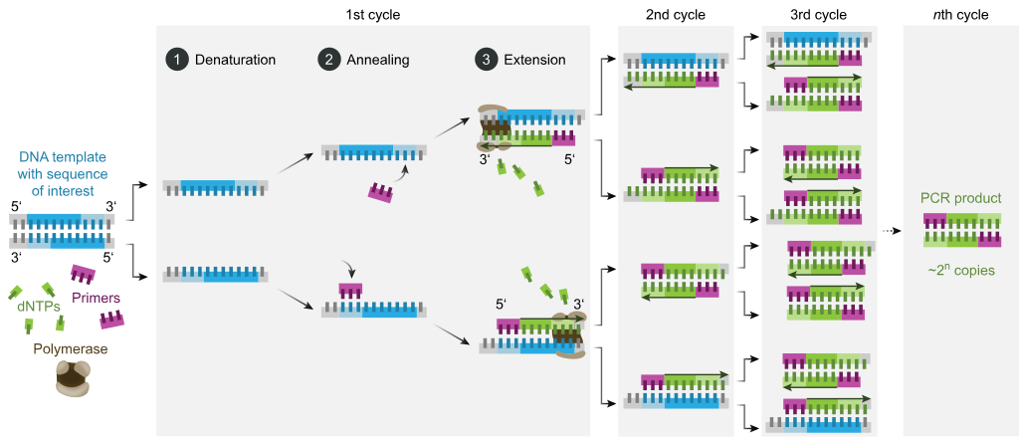
Polymerase chain reaction (PCR)
https://en.wikipedia.org/wiki/Polymerase_chain_reaction

Slide 18
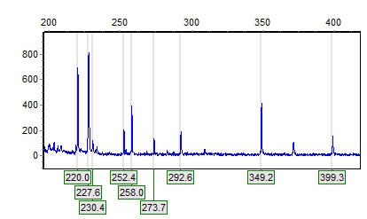
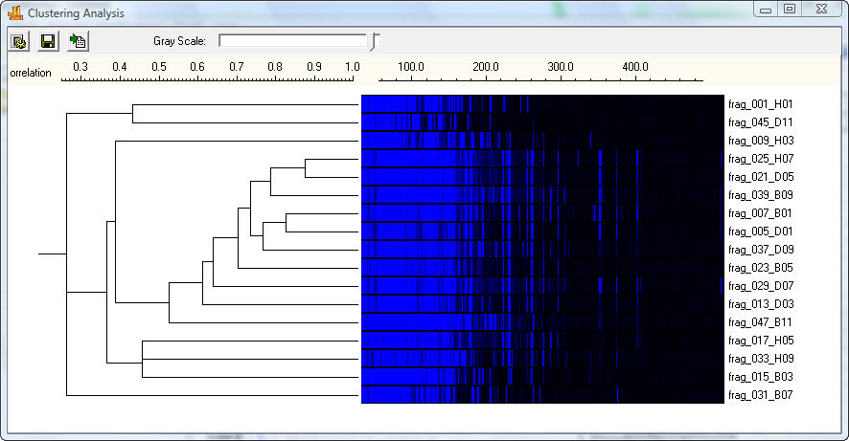
Amplified fragment length polymorphism
https://en.wikipedia.org/wiki/Amplified_fragment_length_polymorphism

Slide 19
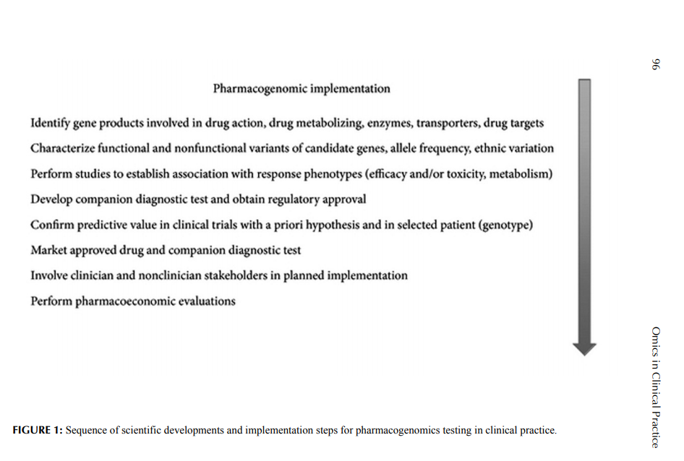
Yu Liu. OMICS in Clinical Practice / 2014 by Apple Academic Press, Inc. – 456 p.

Slide 20
References
Ermak, Gennady (2015). Emerging Medical Technologies. World Scientific. ISBN 978-981-4675-80-2.
Sheffield LJ, Phillimore HE (2009). "Clinical use of pharmacogenomic tests in 2009". Clin Biochem Rev. 30 (2): 55–65. PMC 2702214. PMID 19565025.
Shin J, Kayser SR, Langaee TY (April 2009). "Pharmacogenetics: from discovery to patient care". Am J Health Syst Pharm. 66 (7): 625–37. doi:10.2146/ajhp080170. PMID 19299369.
"Center for Genetics Education“
Pirmohamed M (2001). "Pharmacogenetics and pharmacogenomics". Br J Clin Pharmacol. 52 (4): 345–7. doi:10.1046/j.0306-5251.2001.01498.x. PMC 2014592. PMID 11678777.
Prasad K (2009). "Role of regulatory agencies in translating pharmacogenetics to the clinics". Clin Cases Miner Bone Metab. 6 (1): 29–34. PMC 2781218. PMID 22461095.
Evans DA, Clarke CA (1961). "Pharmacogenetics". Br Med Bull. 17 (3): 234–40. doi:10.1093/oxfordjournals.bmb.a069915. PMID 13697554.
Kalow W (2006). "Pharmacogenetics and pharmacogenomics: origin, status, and the hope for personalized medicine". Pharmacogenomics J. 6 (3): 162–5. doi:10.1038/sj.tpj.6500361. PMID 16415920.
Vogel F. Moderne Probleme der Humangenetik. Ergeb Inn Med Kinderheilk 1959; 12: 52–125
Motulsky AG, Qi M (2006). "Pharmacogenetics, pharmacogenomics and ecogenetics". J Zhejiang Univ Sci B. 7 (2): 169–70. doi:10.1631/jzus.2006.B0169. PMC 1363768. PMID 16421980.
Realities and Expectations of Pharmacogenomics and Personalized Medicine: Impact of Translating Genetic Knowledge into Clinical Practice. 2010

Slide 21
Hasler JA (February 1999). "Pharmacogenetics of cytochromes P450". Mol Aspects Med. 20 (1–2): 25–137. doi:10.1016/s0098-2997(99)00005-9. PMID 10575648.
Ingelman-Sundberg M (April 2004). "Pharmacogenetics of cytochrome P450 and its applications in drug therapy: the past, present and future". Trends Pharmacol Sci. 25 (4): 193–200. doi:10.1016/j.tips.2004.02.007. PMID 15063083
Manolio TA (July 2010). "Genomewide association studies and assessment of the risk of disease". The New England Journal of Medicine. 363 (2): 166–76. doi:10.1056/NEJMra0905980. PMID 20647212

